Slide 1

LAB QUIZ NO: 2
WMA 4B
Lanao, Vian Jay
Ocampo, Geraldine
Padilla, John Xavier
Zamora, Jenny

Slide 2
INSTRUCTIONS
INSTRUCTIONS
Laboratory Problem (Provide with Screenshots)
1. Create a website with git as your version control system. Minimum of 5 web pages. Submit your website in zip file with link using the OneDrive attached in your documentation. The documentation should be submitted in your assignment.
Show the progress of your website using the git and list the content of your git log.

Slide 3
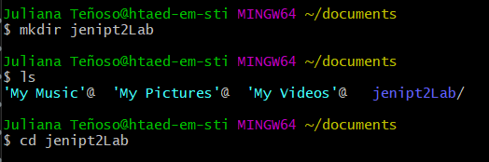
STEP 1 : create your folder

Slide 4
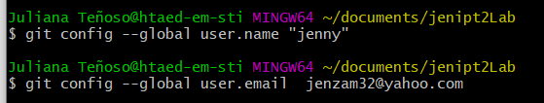
Step 2: create user name & user email

Slide 5
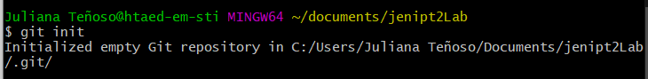
Step 3 : Git init

Slide 6
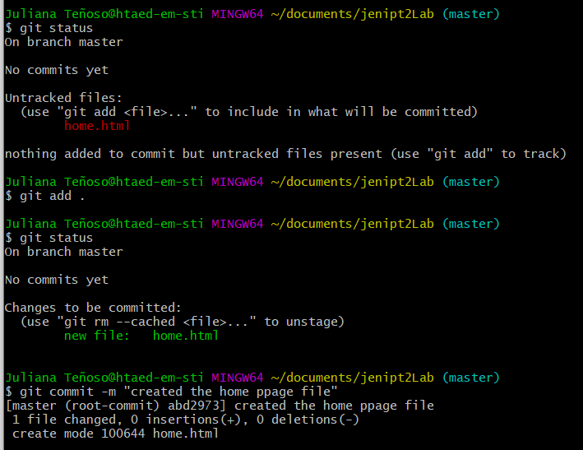
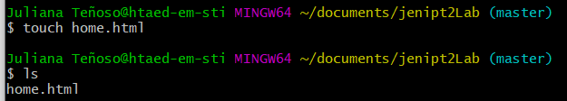
Create the 1st html (home.html) for the homepage use git add . & git commit to save it on the repository

Slide 7
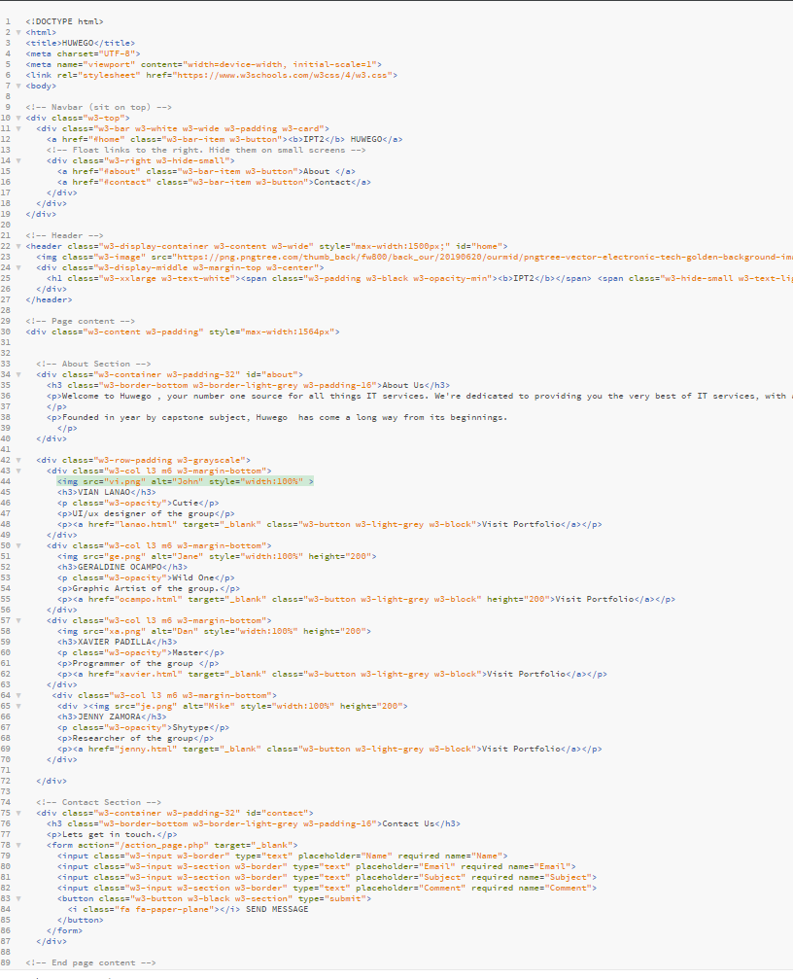
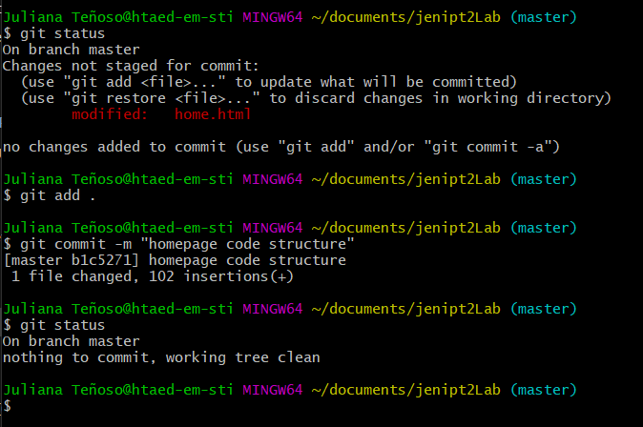
Home.html is modified to save changes on the repo use git add . and git commit

Slide 8
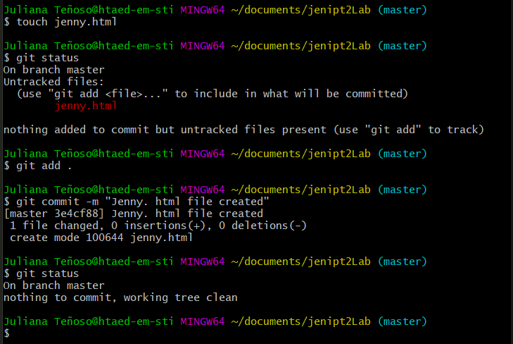
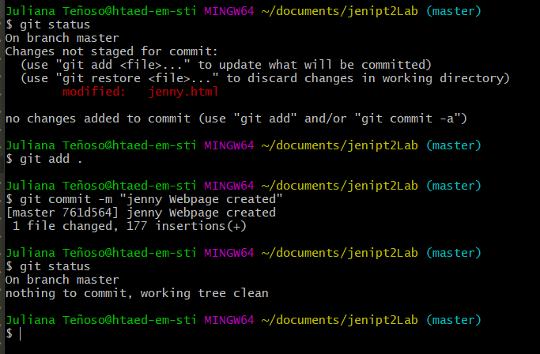
2nd file named jenny.html is created on the git bash using Touch command upon editing the file use git add . And git commit to save changes.

Slide 9
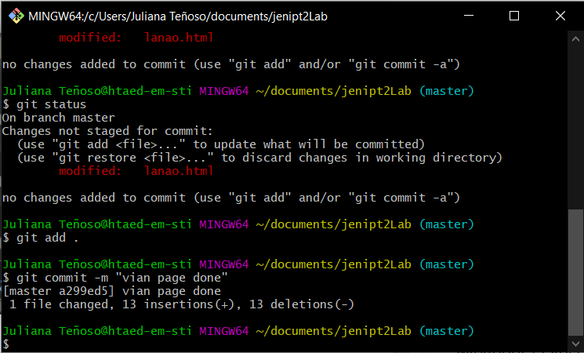
3rd webpage (Lanao.html) is created using touch command
to save changes on the repo use git add . and git commit

Slide 10
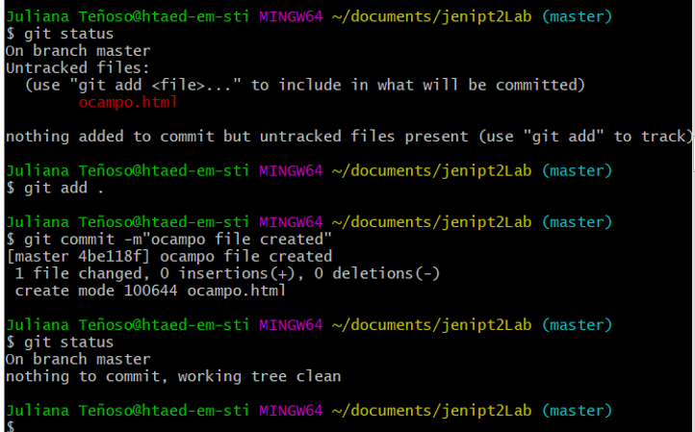
4th webpage is added on the repo (Ocampo.html)
to save changes on the repo use git add . and git commit

Slide 11
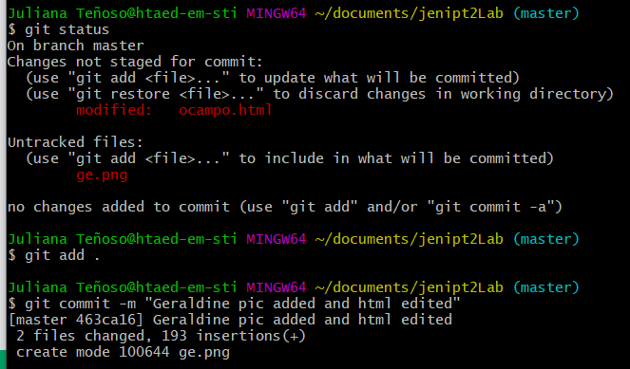
Notice that ge.png is seen upon checking status because I added a file from the folder to save this file from the repo use git add . Then git commit

Slide 12
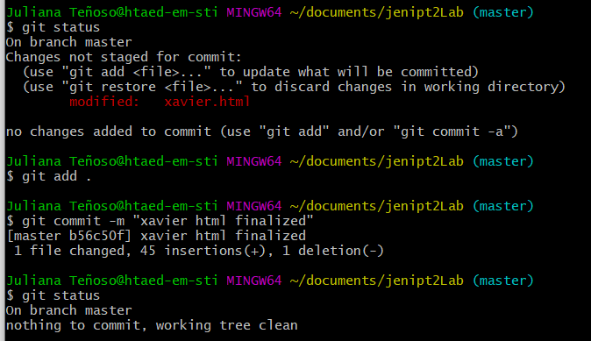
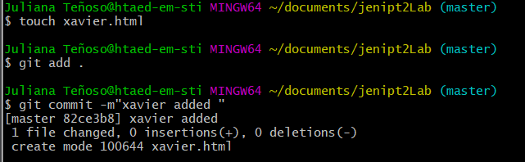
Xavier.html is created using the touch command
to save on the repo use git add . and git commit

Slide 13
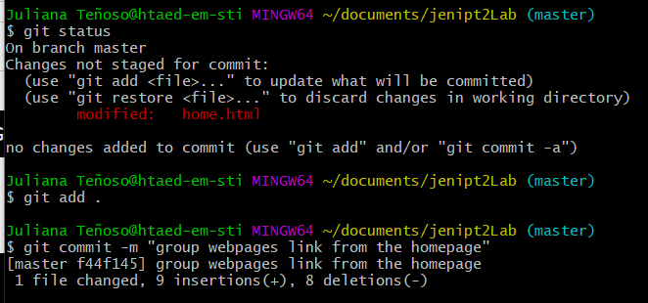
When I finished editing all the webpages. I edited the homepage to link the other pages

Slide 14
Git log:
to view the your history
on git bash
Next are the git log of our group

Slide 15
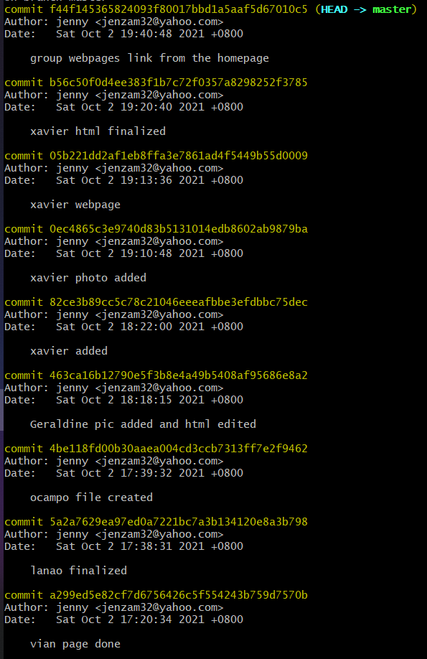
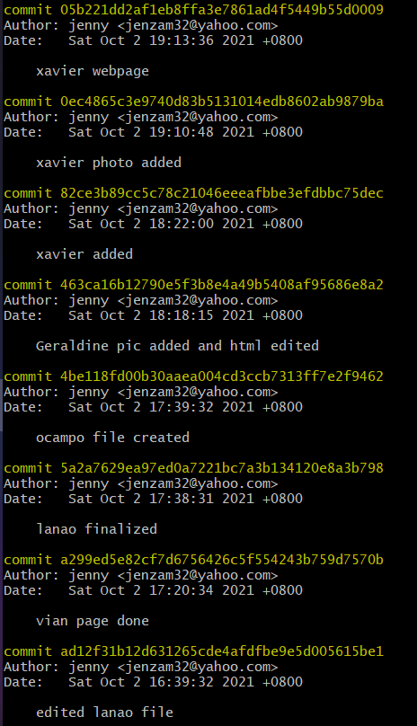
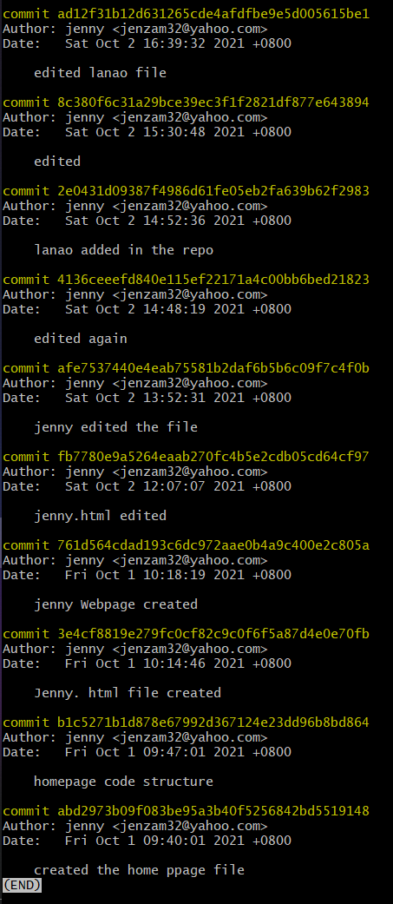
Git log

Slide 16

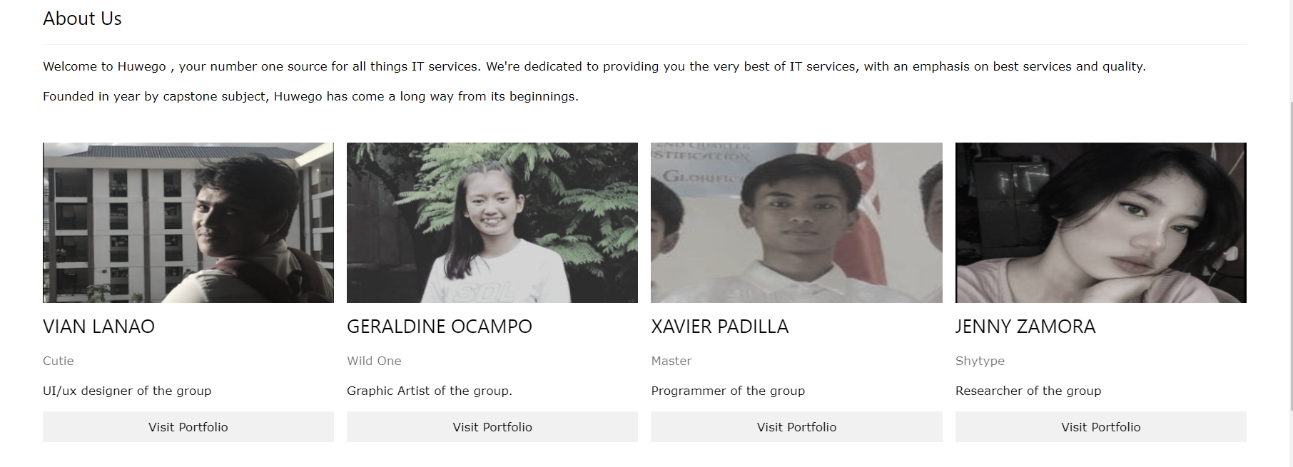
Webpages output
homepage

Slide 17
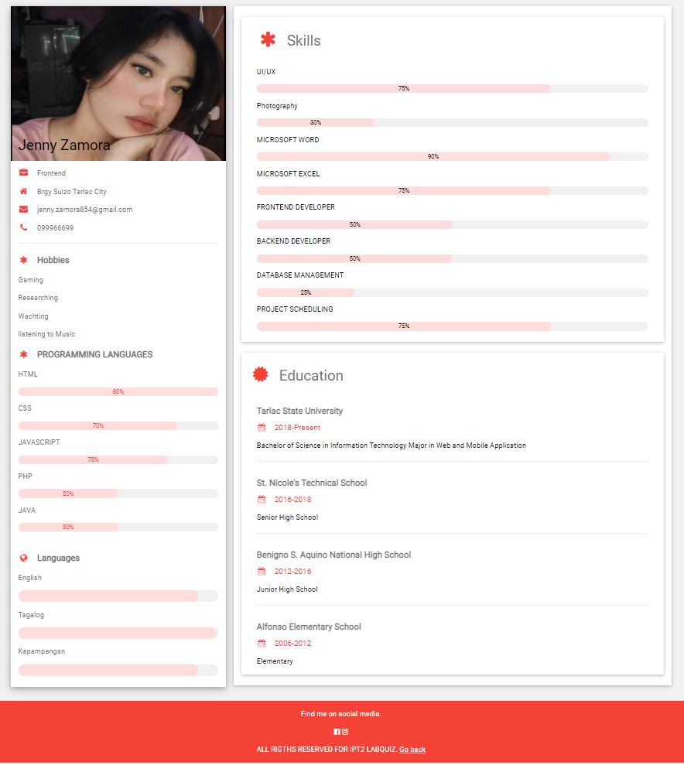
Webpages output
Jenny.html

Slide 18
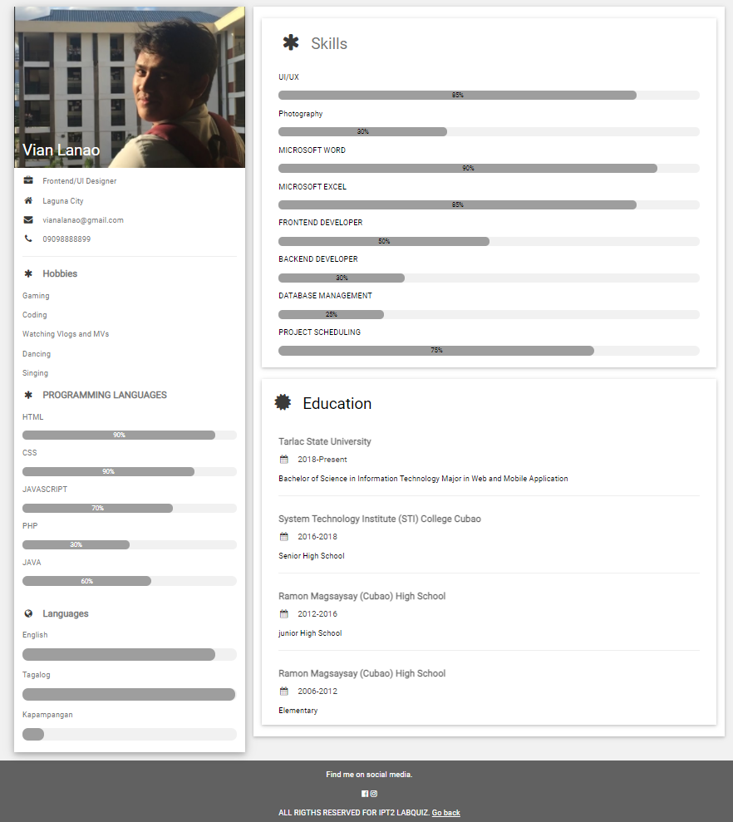
Webpages output
lanao.html

Slide 19
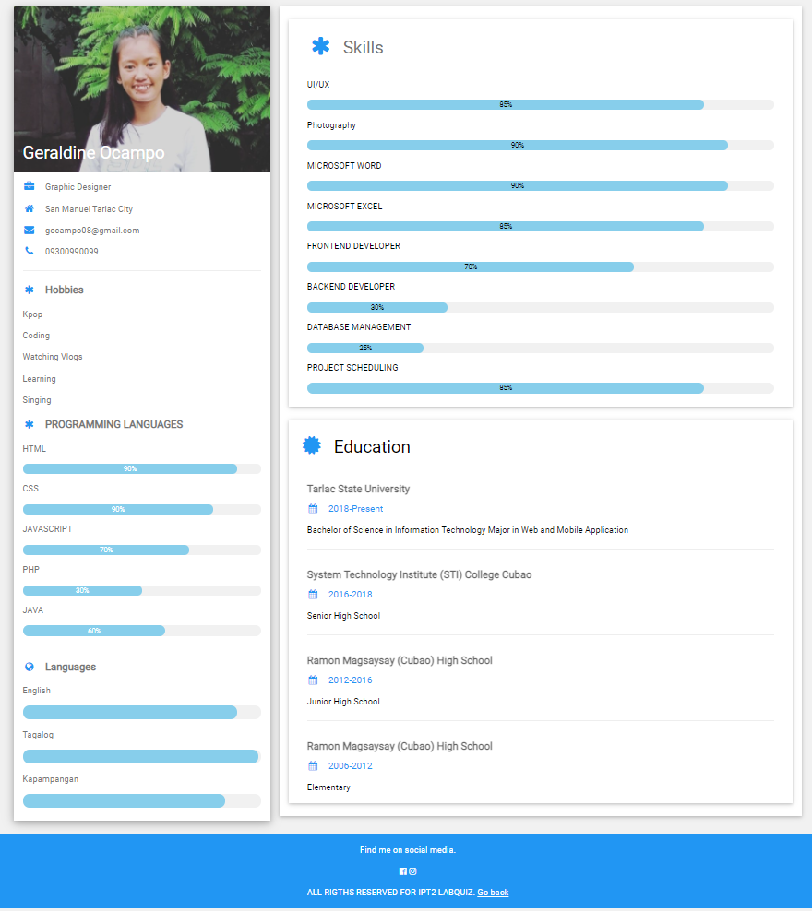
Webpages output
ocampo.html

Slide 20
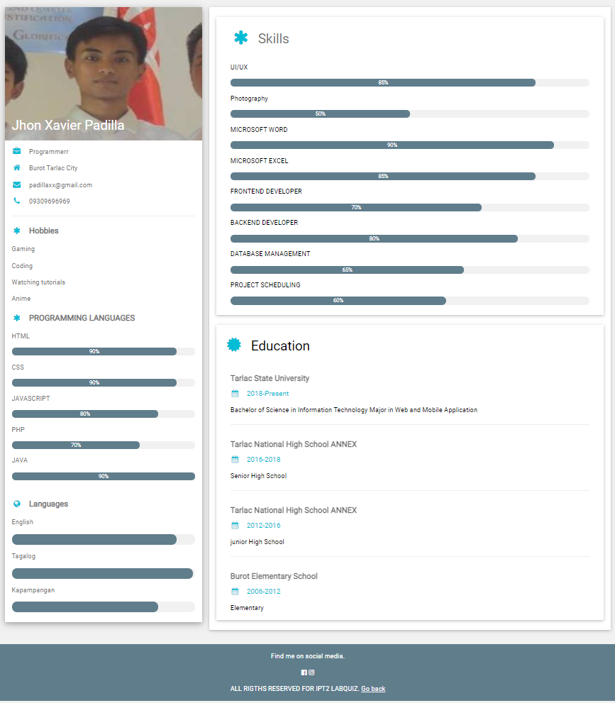
Webpages output
xavier.html

Slide 21
Thank you ☺

